Slide 1
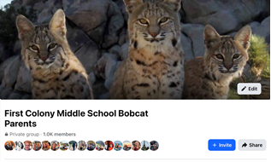
FCMS PTO

Slide 2
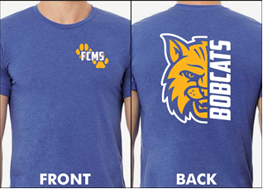

Stop by the PTO table for Bobcat Merch!

Slide 3
Laptop 101
All students will be issued a laptop computer and a charger. Students are not allowed to bring their own laptops to school.
The laptop will have a cover that must stay on the laptop for protection.
FCMS will place a label with the student’s name on the laptop and the charger. Students may not remove the FBISD stickers and barcodes on the laptop.
FBISD policy is that the students have a cover on their laptop at all times.
The laptops are still the property of FBISD and should only be used for school purposes.

Slide 4
General information
Laptops should be charged each night at home.
Students should bring their charger to school in case they need to charge during the school day.
FCMS does not loan out chargers, sell chargers or give students a 2nd charger.
Students are responsible for any damages to the laptop, whether it is an accident or not.
If a student forgets their laptop, they may borrow a one in the Library before 9am only. The student will return it at the end of the day.

Slide 5
Damages to laptop
FBISD offers optional insurance for parents to purchase. The cost is a one time payment of $35 for the year (there is a reduced price for those on free or reduced lunches).
The insurance will allow the students to have two claims for damages to the laptop.
If the student does not have insurance, the parents will be required to pay for the damages to the laptop.
Students should take their laptop the library in the morning if the laptop needs repair.

Slide 6
Fees
Cracked screen- $200 or free with insurance
Missing keys- $65 per key or free with insurance
Lost charger- $20- see next slide
Total damage- $560 or $150 with insurance
Lost laptop- $560 or $150 with insurance
Students with insurance are given 2 claims per school year. Once the 2 claims are used, the full price will be charged.

Slide 7

What to expect When you have a 6th Grader
First Colony Middle School

Slide 8
Elementary Vs Middle School
Parent Newsletter - No Tuesday folders
4:10 PM Dismissal is the bell – not walked out
Classes 50 minutes with a 5 min pass period
No car rider tags
:Outclass” is a Fine Art, Elective and PE class
Tardies are counted after first few weeks
Hall and PE lockers (combo lock needed for PE)
Homework is not optional
Late work policy – 10 points per day

Slide 9
6th Grade Courses:
English Language Arts (ELA)
Math
Science
Social Studies
Physical Education, Pre-athletics OR Kickstart
Fine Art – Band, Choir, Art, Orchestra, Theatre
AVID (study skills, organization, time management)
Math Contest
Advisory = Tuesdays and Wednesdays

Slide 10

What is Career and Technical Education(CTE)?
Our students define CTE as a program that involves academic and hands-on skills to prepare students for a specific career that they want.
Career and Technical Education is a strategic educational plan for all students. It allows for academics, creativity and skills to merge therefore sparking career interest that will carry them from high school to college and career.
Notes:
Counselors will say:
“Our students describe CTE as a program that combines academics with hands-on skills. It’s not just theory, t’s practical learning that prepares them for the specific careers they’re passionate about. Career and Technical Education is more than an elective. It’s a strategic educational plan designed for all students. It creates opportunities where academics, creativity, and technical skills intersect. The goal is to spark career interest early and provide a clear pathway from high school to college and into the workforce. CTE equips students with the tools they need to succeed in both higher education and their chosen careers.”
“Think about the impact: students leave high school not just with knowledge, but with real-world skills and confidence to pursue their future.”

Slide 11

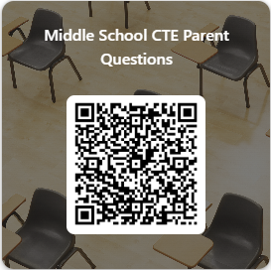
CTE Courses available for Middle School 26.27
6th Grade | 7th Grade | 8th Grade
Technovation I | Touch System Data Entry/Dollars and Sense | Fundamentals of Computer Science
 | Career and College Exploration | Principles of Human Services
 | Technovation II | Technovation II
 |  | Touch System Data Entry/Dollars and Sense
 |  | Career and College Exploration
To enroll your incoming 6th grader in Technovation I or a rising 7th or 8th in Technovation II, make sure to select the course during course selection, use one of your elective spaces to add the course.

Slide 12
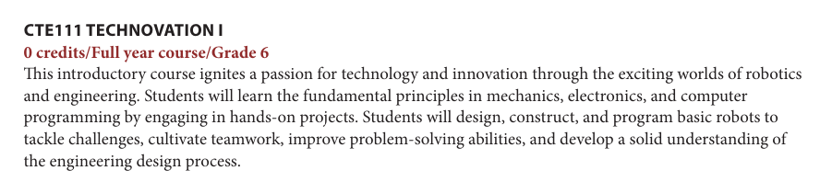

Slide 13
Level Options:
On-Level or AAC
English • Math • Science• Social Studies

Slide 14
AAC = Advance Academic Course
Higher level of rigor
Fast –paced
Additional daily study time is needed
Special assignments: Science Fair, History Project, etc.
GT students are required to enrolled in identified area (Math/Science, ELA/SS)

Slide 15


AAC MatH 6
Accelerated Curriculum
100% of 6th Grade TEKS
51% of 7th Grade TEKS
Covers 150% of the middle school TEKS. Students spend less time in a math classroom than they do in Elementary School.

Slide 16
Senate Bill 2124
Please note, in compliance with Senate Bill 2124, students who score in the top 40% on 5th grade STAAR are automatically enrolled in Grade 6 Math AAC.
The standards covered in each middle school math course are listed below. Due to the acceleration, multiple grade level TEKS are covered in grades 6 and 7, to prepare students for Algebra in Grade 8.
Grade 6 Math AAC covers: 6th grade TEKS and some 7th Grade TEKS (students will take 6th grade STAAR)
Grade 7 Math AAC covers: 7th grade TEKS and all 8th Grade TEKS (students will take7th grade STAAR)
Algebra I AAC, and cover Algebra I TEKS (students will take Algebra I EOC STAAR)
If your student chooses not to be automatically enrolled in Grade 6 Math AAC, they should enroll in Grade 6 On-Level Math and inform the middle school counselor.

Slide 17
Success in AAC
Consistent, strong performance in subject area (Grades, REN360, Tests, Quizzes, STAAR scores)
Organized
Self-disciplined
Highly motivated

Slide 18
On-Level
On-level classes – High standards, strong academic focus
Both levels prepare students for high school
Not “All or Nothing” – Student does not have to take all On-level or all AAC, student can select levels based on interests and strengths

Slide 19
Proven Strategies for School Success:
Check grades together on Skyward Family Access (parent and student)
Organization – Breaking down assignments (do not do everything the day before)
Planner – Use daily for organization (paper or app)
Check Schoology (parent and student)
Limit technology during school week
Family Calendars
Pack homework the night before (binder or folder)

Slide 20
Course Verification Window
Verification Window in Skyward March 9 – 13
Review Course Requests in Skyward.
If you would like to make changes, print out and update your requests.
This will be the last opportunity to request changes.

Slide 21
Elective classes
In order to maintain balance of classroom numbers and to minimize disruptions to the academic process, schedule changes will only be made to correct on error:
A student has already taken a class in which they are currently scheduled.
A male has been scheduled into a female PE/Athletics, or vice versa
A student is in a class for which they do not have the appropriate prerequisite (i.e., enrolled in Art I and has not taken Art II).

Slide 22
Guidelines for Exiting aAC Course
Fort Bend ISD 079907
EED-R
Requests to level down will be considered after the first three (3) weeks of school and only if space is available in the new class. Prior to requesting a change in level, the student and parent must have met with the teacher and put in place a plan for success. If the teacher and student feel the plan has been followed, and the student has completed all assignments, a request for a conference to discuss removal may be made. Success in an AP or AAC course is defined as having a grade of 75 or above. Students may not request a level change with the intent to improve their GPA.

Slide 23
Follow-up questions
For individualized questions/advice on your child’s course selection, please contact your child’s elementary school counselor.
The elementary school counselors and fifth grade teachers have experience and helpful information available for parents and students regarding the transition to middle school.

Slide 24
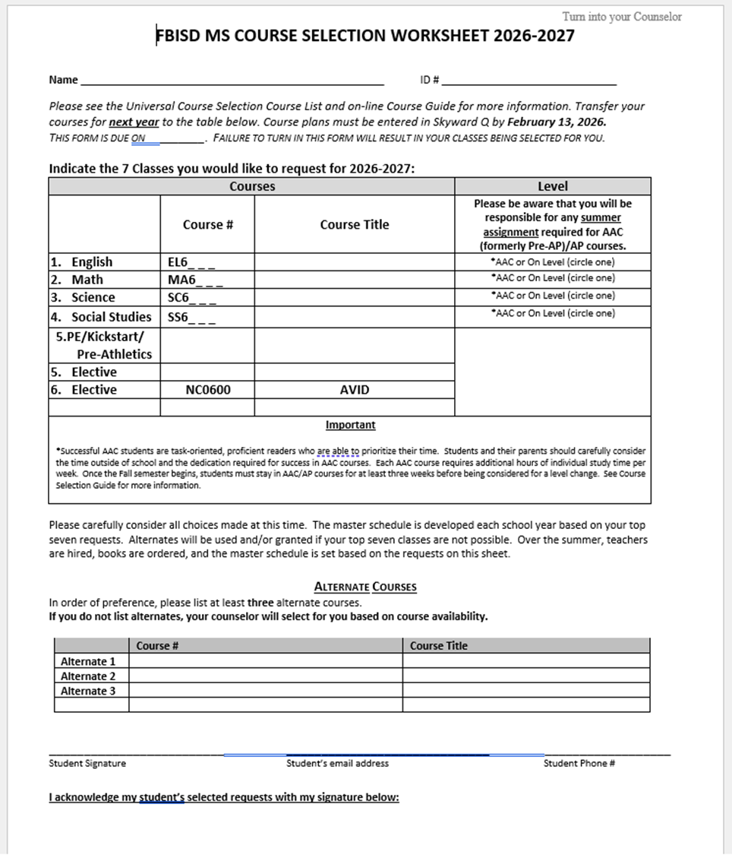
Due February 13, 2026
To ES Counselors
Last day to make changes is March 13

